Slide 1
BECOMING A REFERRAL MAGNET
HOW TOP ADVISORS INCREASE HIGH NET WORTH REFERRALS AND CONVERSIONS
Presented by Kelly Edwards
CEO of Lawton Marketing Group and author of The Referral Magnet

Slide 2
A LITTLE ABOUT
OUR AGENCY
Full-service branding & marketing agency for elite advisors and teams
In-house team of 17
HQ in Oklahoma, with clients in all 50 states and Canada
15+ national & international awards for creative work
Author of The Referral Magnet
100+ Northwestern Mutual clients

Slide 3
WHY I’M
HERE TODAY
Your industry is an anomaly.
The way HNW consumers find an advisor is unique.
Most branding and marketing advice does not apply to you.

Slide 4
How do people find advisors?
It all starts with asking people they know and trust, “Do you have a good advisor you recommend?”
This industry will always be referral-centric, especially with HNW clients, so maximizing your referability is crucial to your growth.
Becoming a referral magnet is a two-part process:
Part one: Creating an awesome brand
Part two: Driving more people to you

Slide 5
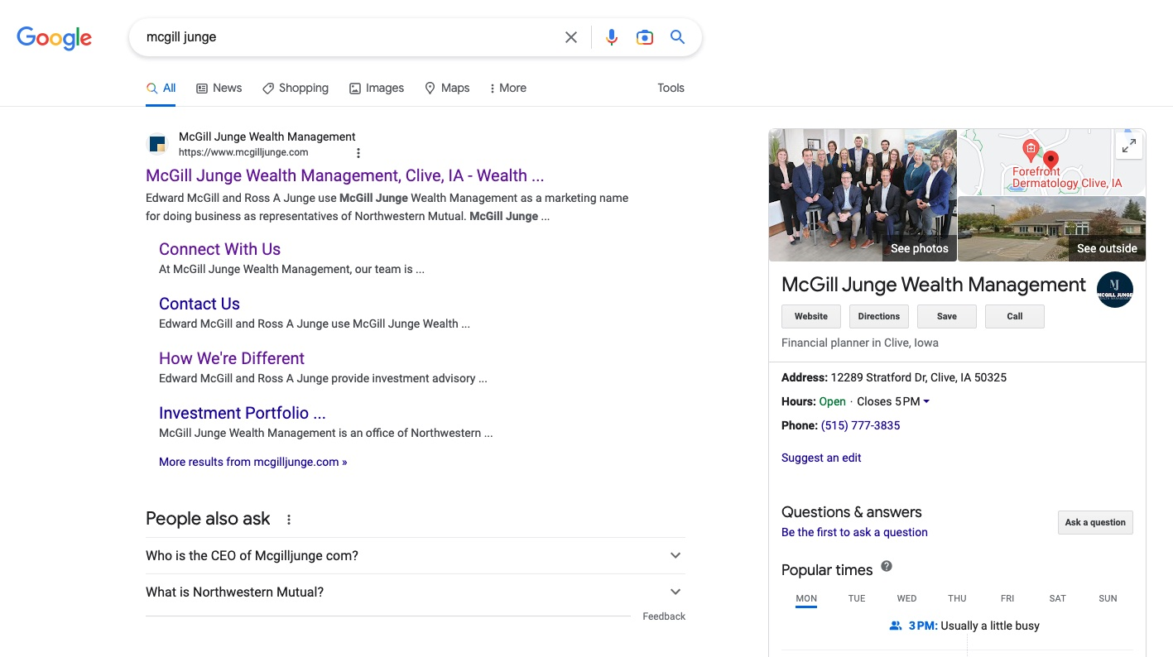
PART ONE
CREATING AN AWESOME BRAND

Slide 6
WHAT IS YOUR “BRAND” ANYWAY?
VISUAL: What do your clients see?
You, your office, your team, your website, your business cards, etc.
VERBAL: What do they hear?
Your elevator pitch, your voicemail, your tone, your story, etc.
EXPERIENTIAL: What do they experience?
Your service, your attention to detail, your gifts, your touchpoints, etc.
Visual
YOUR
BRAND
Experiential
Verbal

Slide 7
WHAT REALLY MATTERS IN BRANDING?
To have a truly great brand:
The “icing on the cake” matters.
Consistency matters.
Intentionality matters.
Who do I want to attract?
What do I want to be known for?

Slide 8
BRAND ELEMENT #1:
COMPANY NAME AND LOGO
Does a DBA make sense for my practice?
What type of name
do I need?
What’s important
for my logo?

Slide 9
BRAND ELEMENT #2:
YOUR WEBSITE
It’s primarily a conversion tool, not a marketing tool.
It’s the one place that tells the whole story.
Everything else is designed to drive people there.
Almost every prospect will vet you there.
The role of your website may be different than you think!

Slide 10
BRAND ELEMENT #3: YOUR STORY
Big Mistake: “The content on my website doesn’t matter. No one is reading it anyway.”
Your content seals the deal or drives people away. So it’s not about having content; it’s about having the right content.
That includes:
Who you are and how you’re different
Who you work with and what you do for them
How to get in touch
Thought leadership & credibility content

Slide 11
3 RULES FOR CONTENT
RULE #1: Canned content that was not written about you and for your ideal prospects is not going to perform well
RULE #2: Aim to be different, but never put being different ahead of being right
RULE #3: Less is more when it comes to written content - with one exception

Slide 12
THE EXCEPTION:
YOUR BIO
Why does your bio as an advisor matter so much?
What about staff member bios?
THE FORMULA:
Start with now
Share everything
Segment it
Lift the veil

Slide 13
Other BRANDING ELEMENTS
Social media profiles
Videos
Capabilities decks
Welcome packets
Branded swag

Slide 14
PART TWO
ATTRACTING MORE
OF YOUR IDEAL PROSPECTS

Slide 15
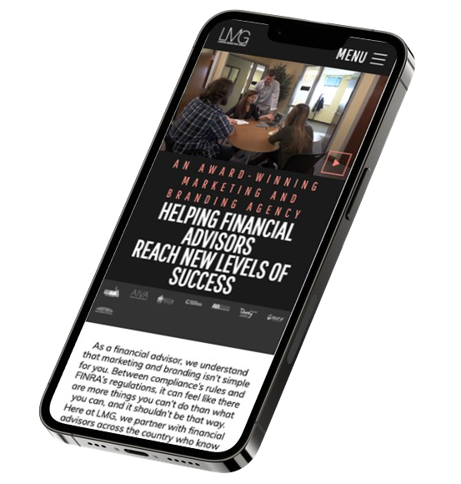
STRATEGY #1:
Search Engine Optimization
THE CRITICAL QUESTIONS TO ASK
Who am I trying to attract?
What do I want to rank for?
Optimize for phrases, not keywords or ideas
Branded vs. Unbranded search
How can it be done?
Content is King
Blogging, Press Releases, Videos

Slide 16
STRATEGY #2: Social Media MARKETING
3 Growth
Strategies
Relationships & Referrals
SEO & Increasing
Conversions
Reaching
New Markets

Slide 17
STRATEGY #3:Client Touches
Doing what matters. Doing what works.
Information Touches
Newsletters
Emails
“Saw this and thought of you” content
Client Events
Big vs. Small
Social vs. Educational
In-Person vs. Virtual
Piggybacking on other events
Strategic Gifting
Planned Gifts
Opportunity Gifts

Slide 18
STRATEGY #4:
BOOSTING CREDIBILITY
Testimonials
Awards
Press Releases

Slide 19
THANK YOU FOR YOUR TIME!
NEED HELP?
QUESTIONS?
EMAIL: KELLY@LAWTONMG.COM
WEBSITE: WWW.LAWTONMG.COM
CALL: (580) 275-2063 EXT. 1

